Slide 1
ALARM MONITORING AND AUTOMATION
Presented By
Jared Dominic Fernandez

Slide 2

Oracle Database
Relational database management system (RDBMS) from the Oracle Corporation.
The system is built around a relational database framework in which data objects may be directly accessed by users (or an application front end) through structured query language (SQL).
Architecture is split between the logical and the physical.
Allows for a robust system to be devised due to the absence of a single point at which a failure can bring down the database, ensuring that any failure would be local only.

Slide 3
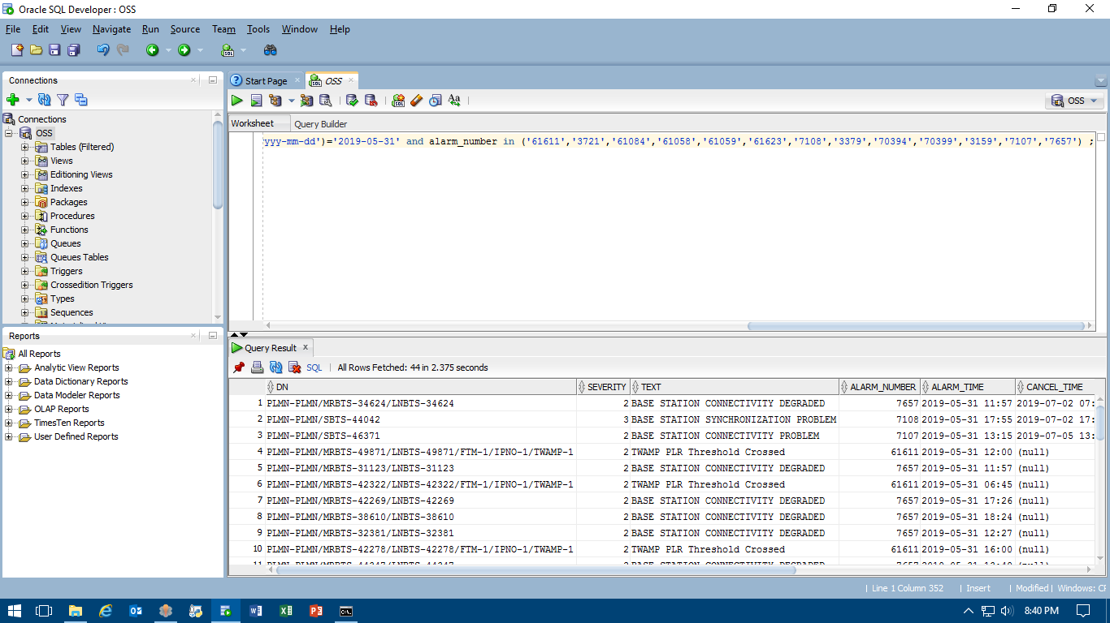
Oracle sql developer
Graphical Tool
Database Development Tasks
Query Result
Data Export

Slide 4
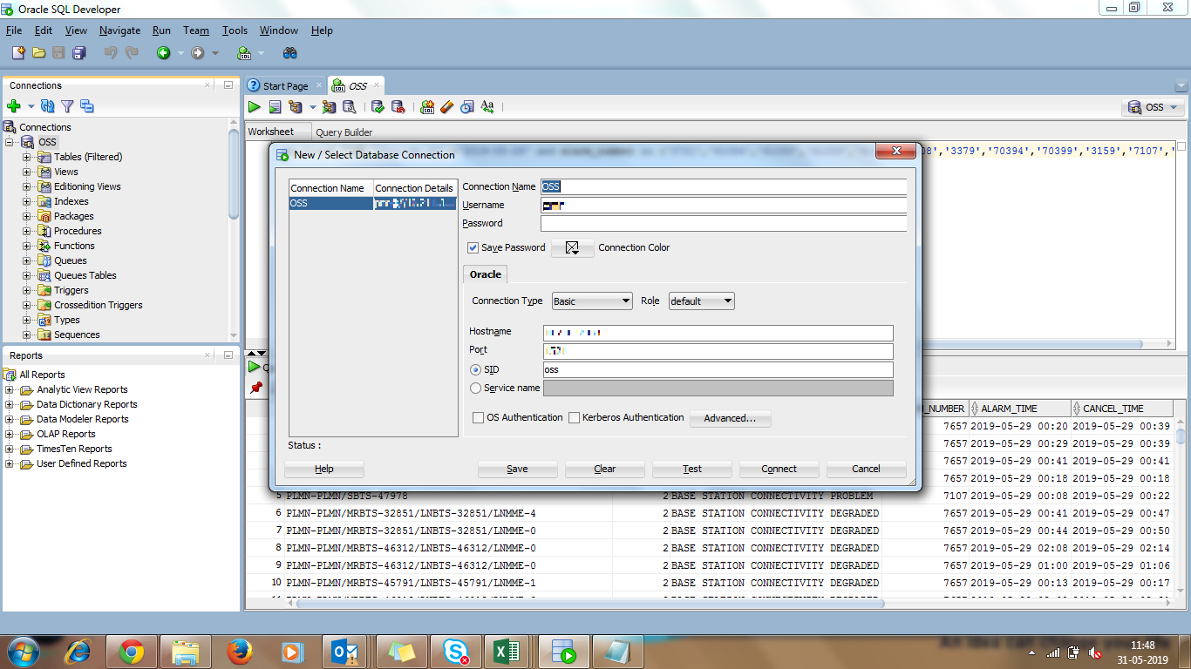

Slide 5

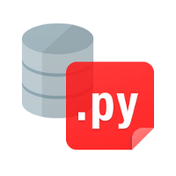
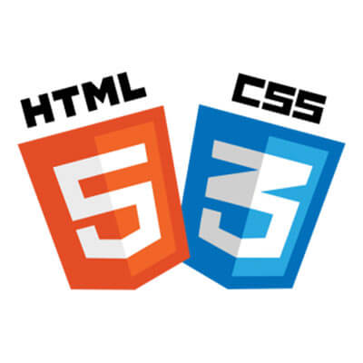

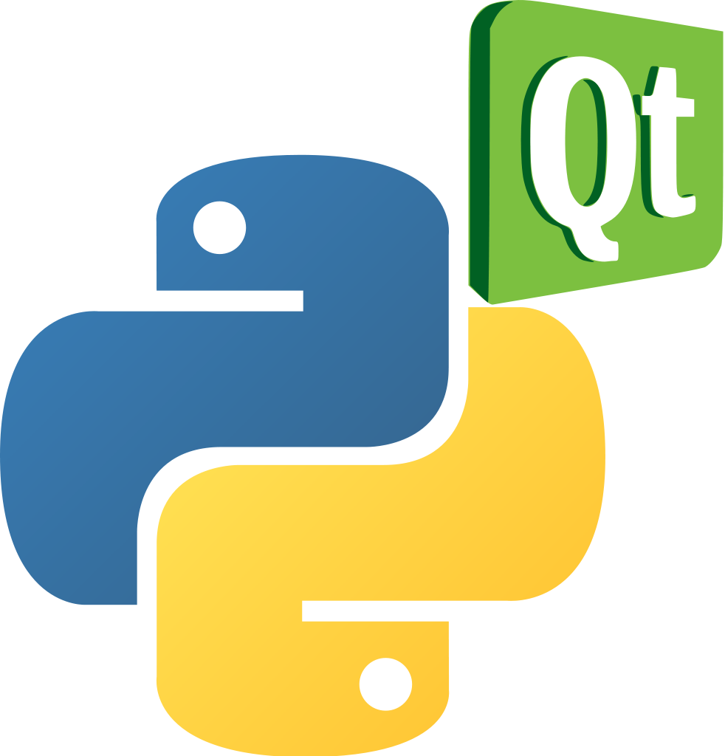



Slide 6
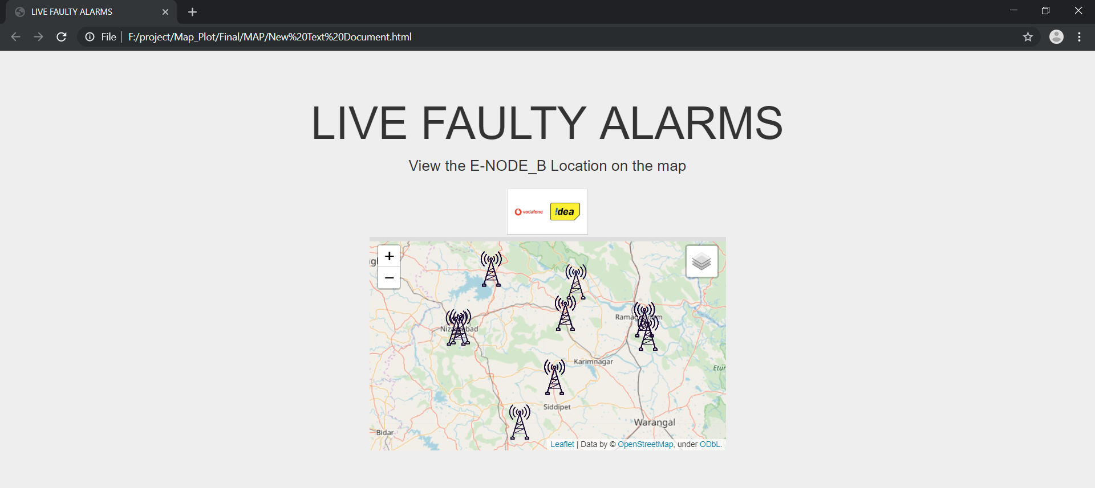
Live faulty alarms webpage
Created using HTML and CSS
Map embedded to main html page
eNodeB – cell tower icon
Data mapped using Folium and Pandas

Slide 7
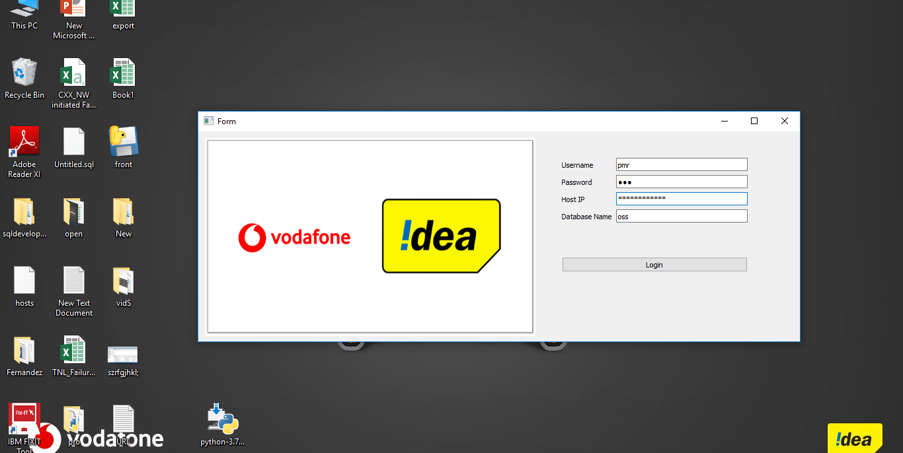
Alarm data Application

Slide 8
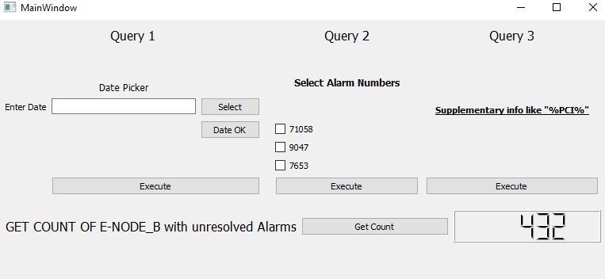
Main Window
Each query/task takes in a required variable input from the User.
The final necessary output is provided in an Excel File named in the <file_name>+<date_stamp> form
LCD_tag shows the number of eNodeB’s with unresolved live alarms.

Slide 9
THANK YOU

